Slide 1
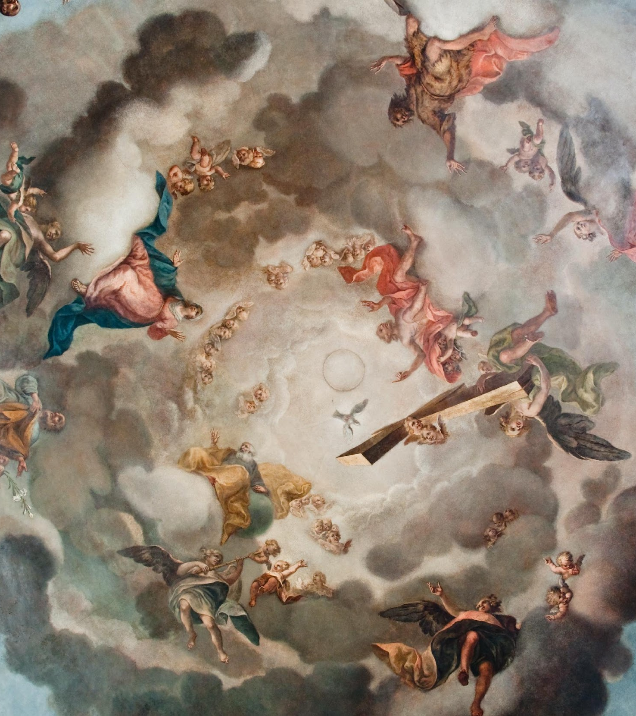
The Mechanics of Printing
Rosenn Nicolas and Brenda Luies

Slide 2
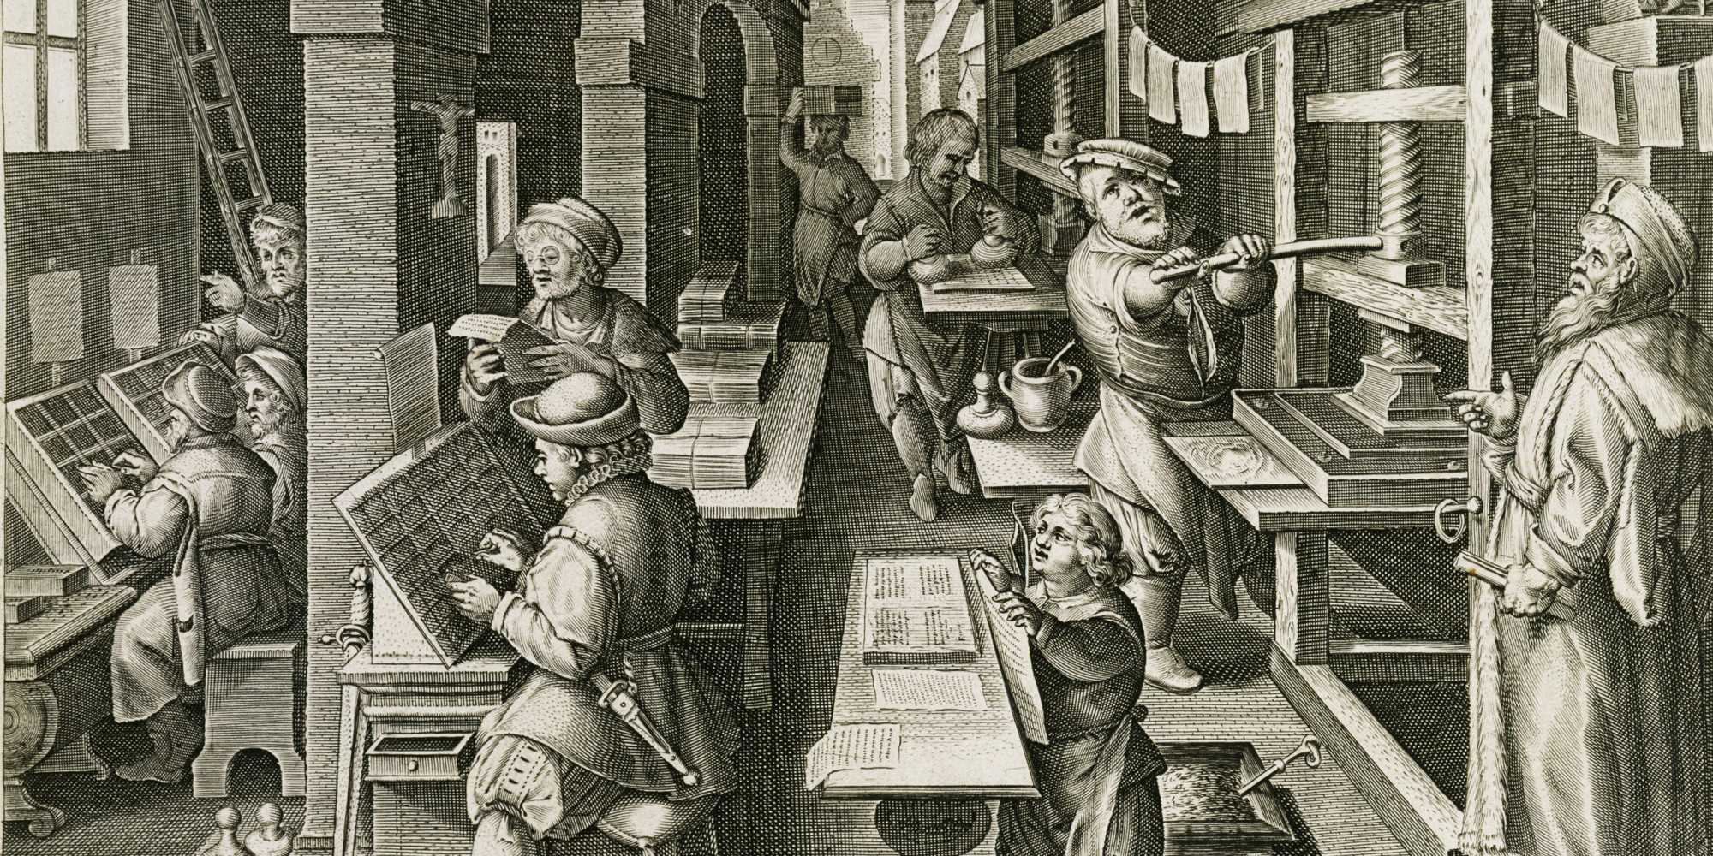
In the printing shop

Slide 3
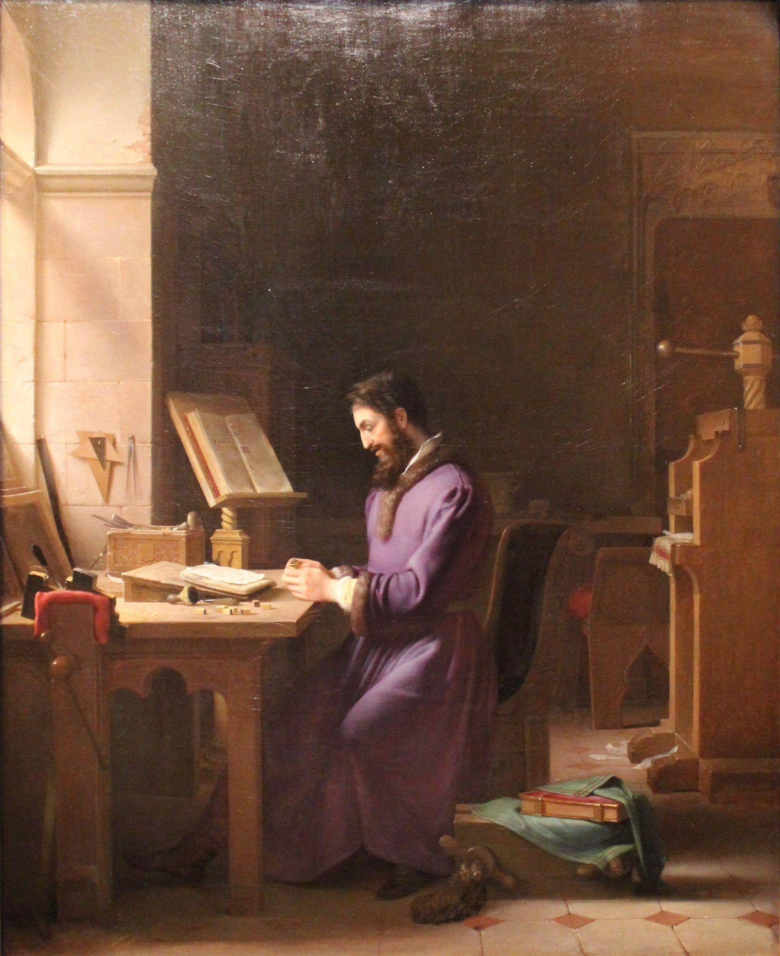
In the printing shop
Who worked in the printing shop?
Printers not alone in their shop
shop = centre of the book production

Slide 4
In the printing shop
Who worked in the printing shop?
compagnonnage system = master and apprentices
full of different tasks = master, pressman, composer, translator, corrector, author, binder…

Slide 5
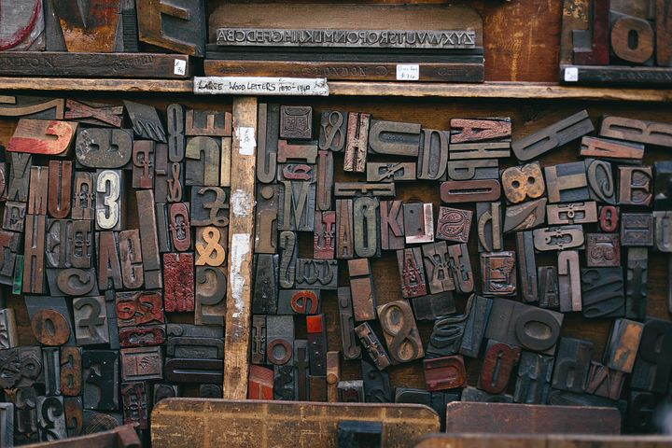
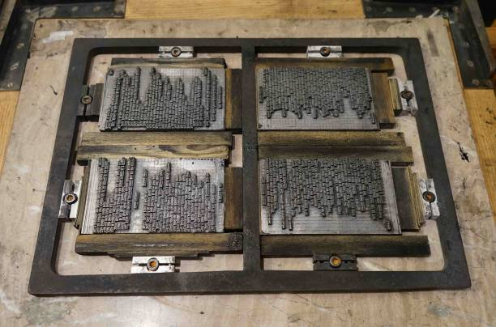
In the printing shop
What was the material?

Slide 6
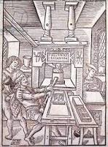
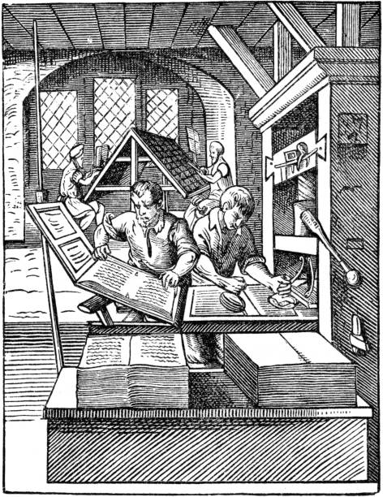
In the printing shop
What was the material?

Slide 7
How to make a book?

Slide 8
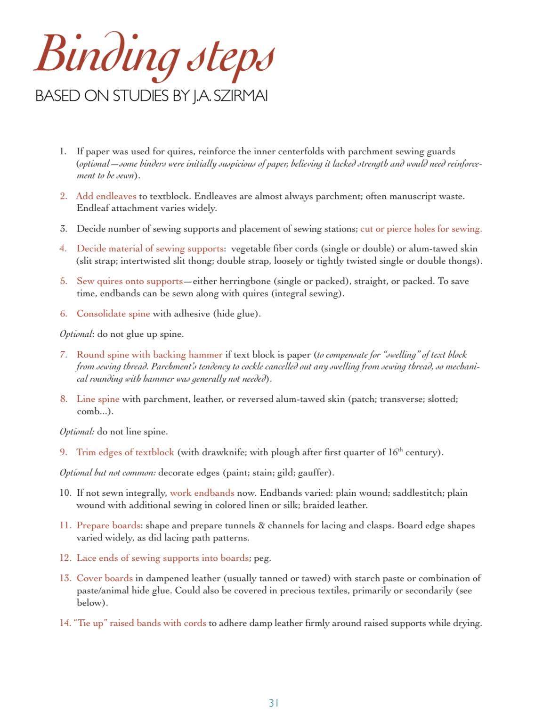
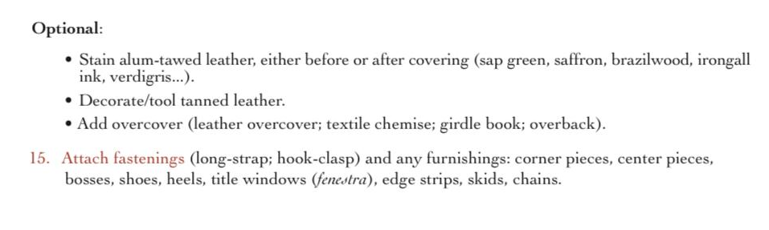
How to make a book?
Bindings and Fragmentology
Special Collections Conservation Unit of the Preservation Department of Yale “Binding Steps: Based on studies by J.A Sizmani” Gothic Western Stiff-board bindings Circa Xii-XVI Century. Medieval to Early Modern Manuscripts: BOOKBINDING TERMS, MATERIALS, METHODS, AND MODEL. Center for Library Preservation and Conservation: Yale University, 2016. chrome-extension://efaidnbmnnnibpcajpcglclefindmkaj/https://travelingscriptorium.files.wordpress.com/2021/03/binding-booklet-2016.pdf

Slide 9
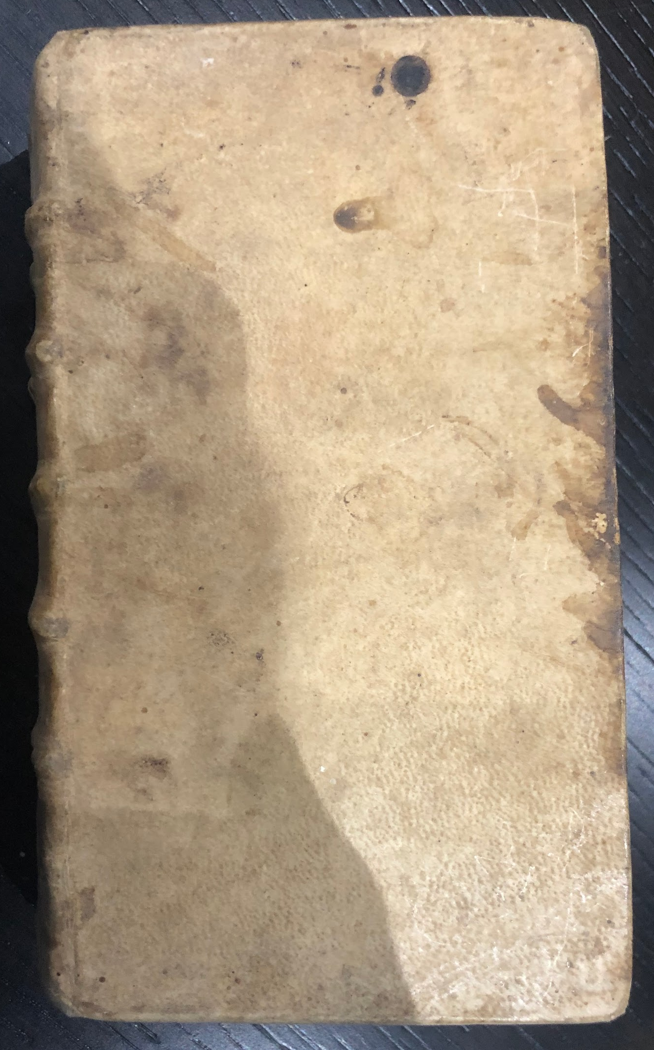
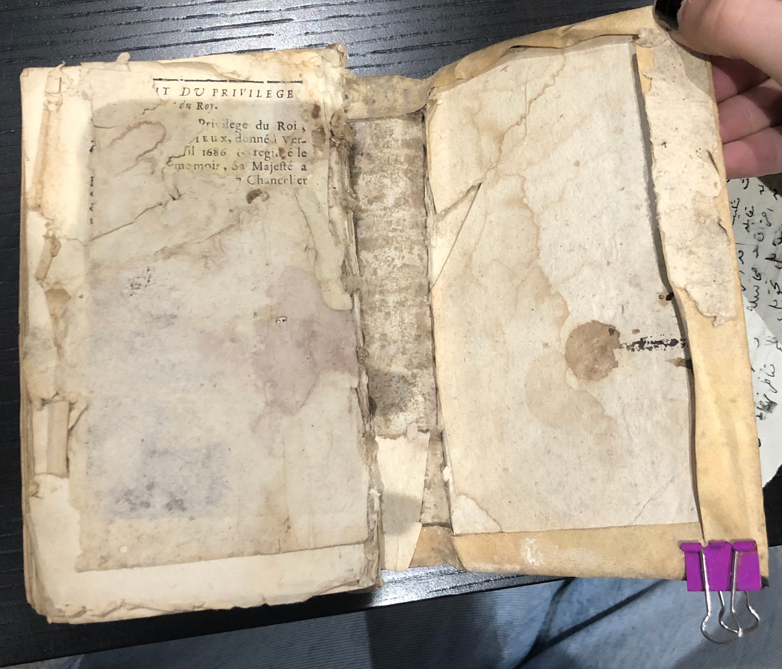
How to make a book?
Spine
Tongue
Sewing Support/Stitching
turn-in/ foldover
Lower/Right board

Slide 10
How to make a book?

Slide 11
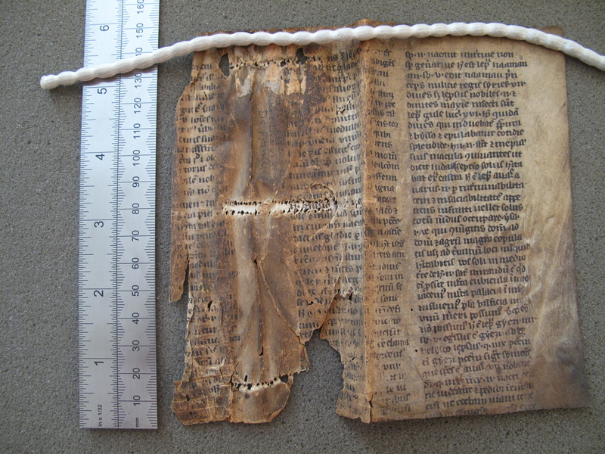
How to make a book?
Bindings and Fragmentology
Segment of parchment bifolium, used as book cover for unidentified text. Theological work on the healing of lepers. Marsh's Library Exhibits ‘Manuscript Fragments’; accessed March 18, 2024, https://www.marshlibrary.ie/digi/exhibits/show/ms-frags/item/165

Slide 12
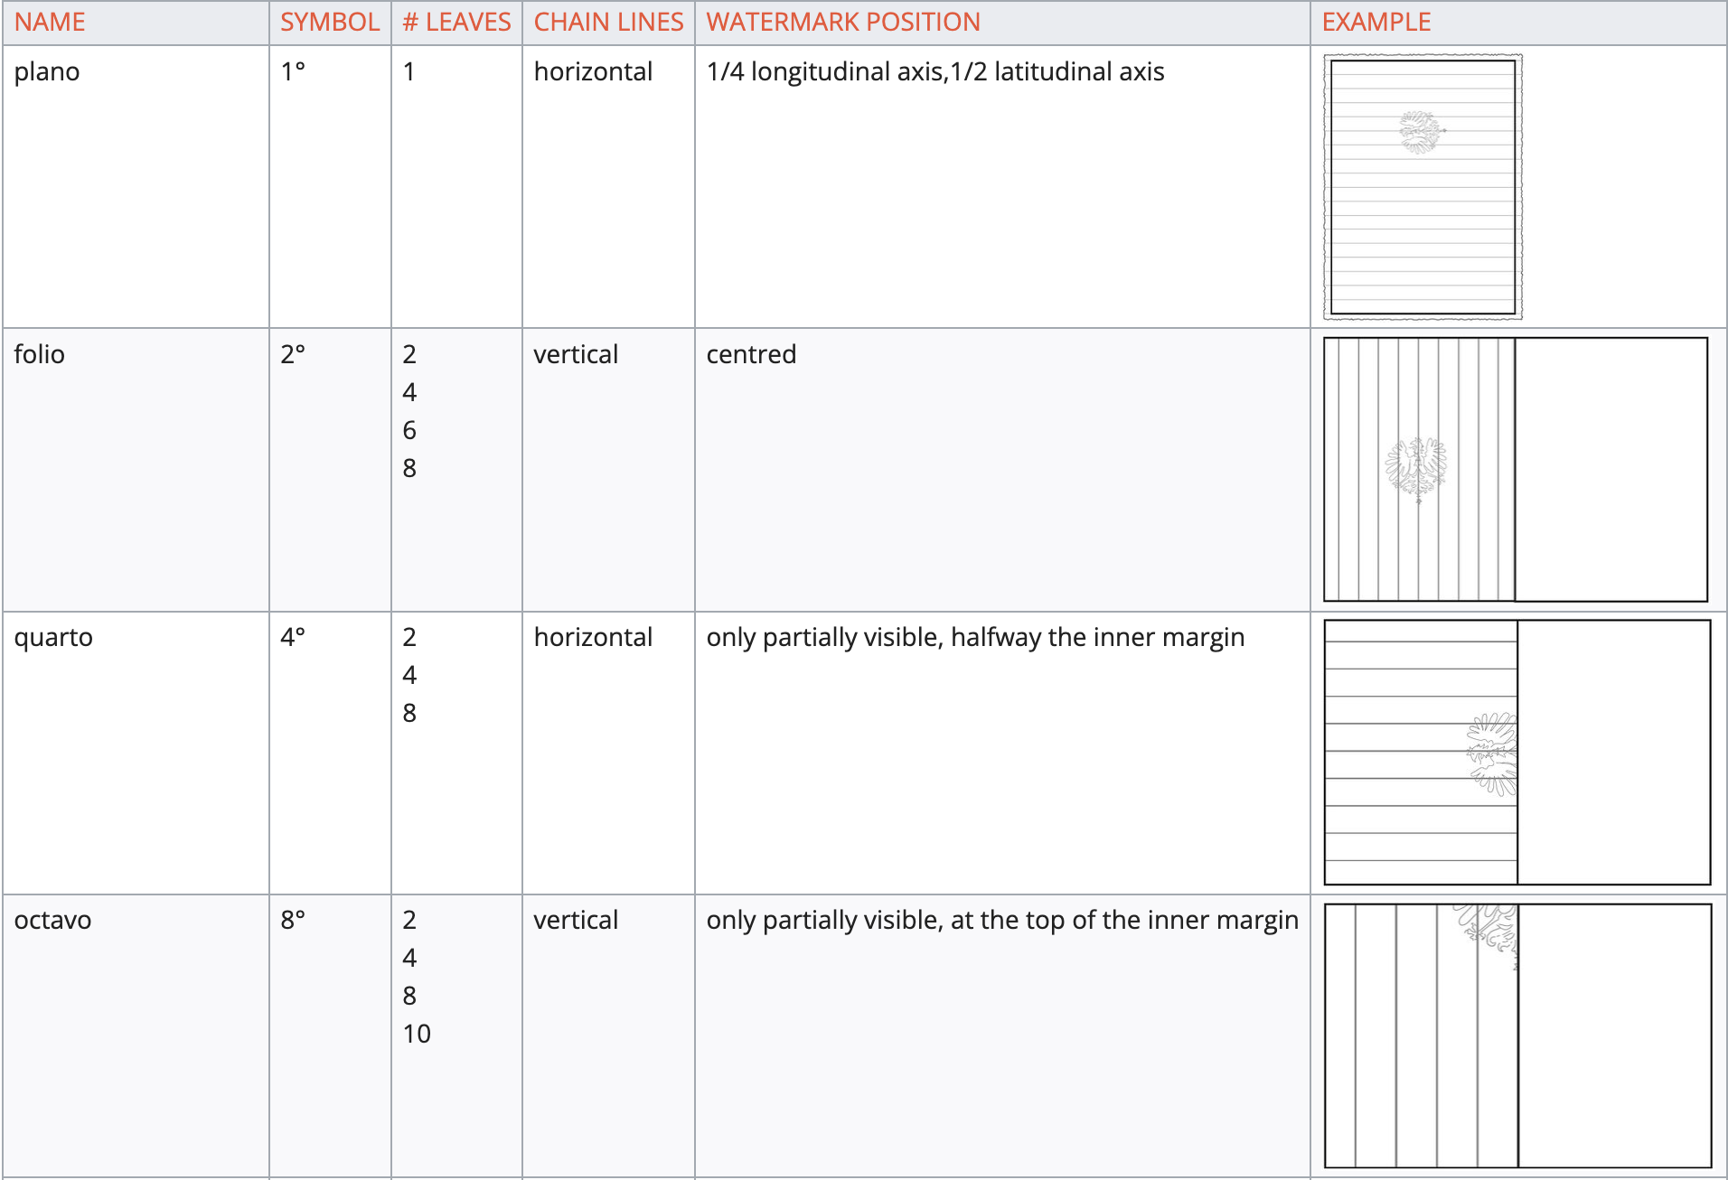
How to make a book?
The printing process
https://manual.stcv.be/p/List_of_Bibliographical_Formats

Slide 13
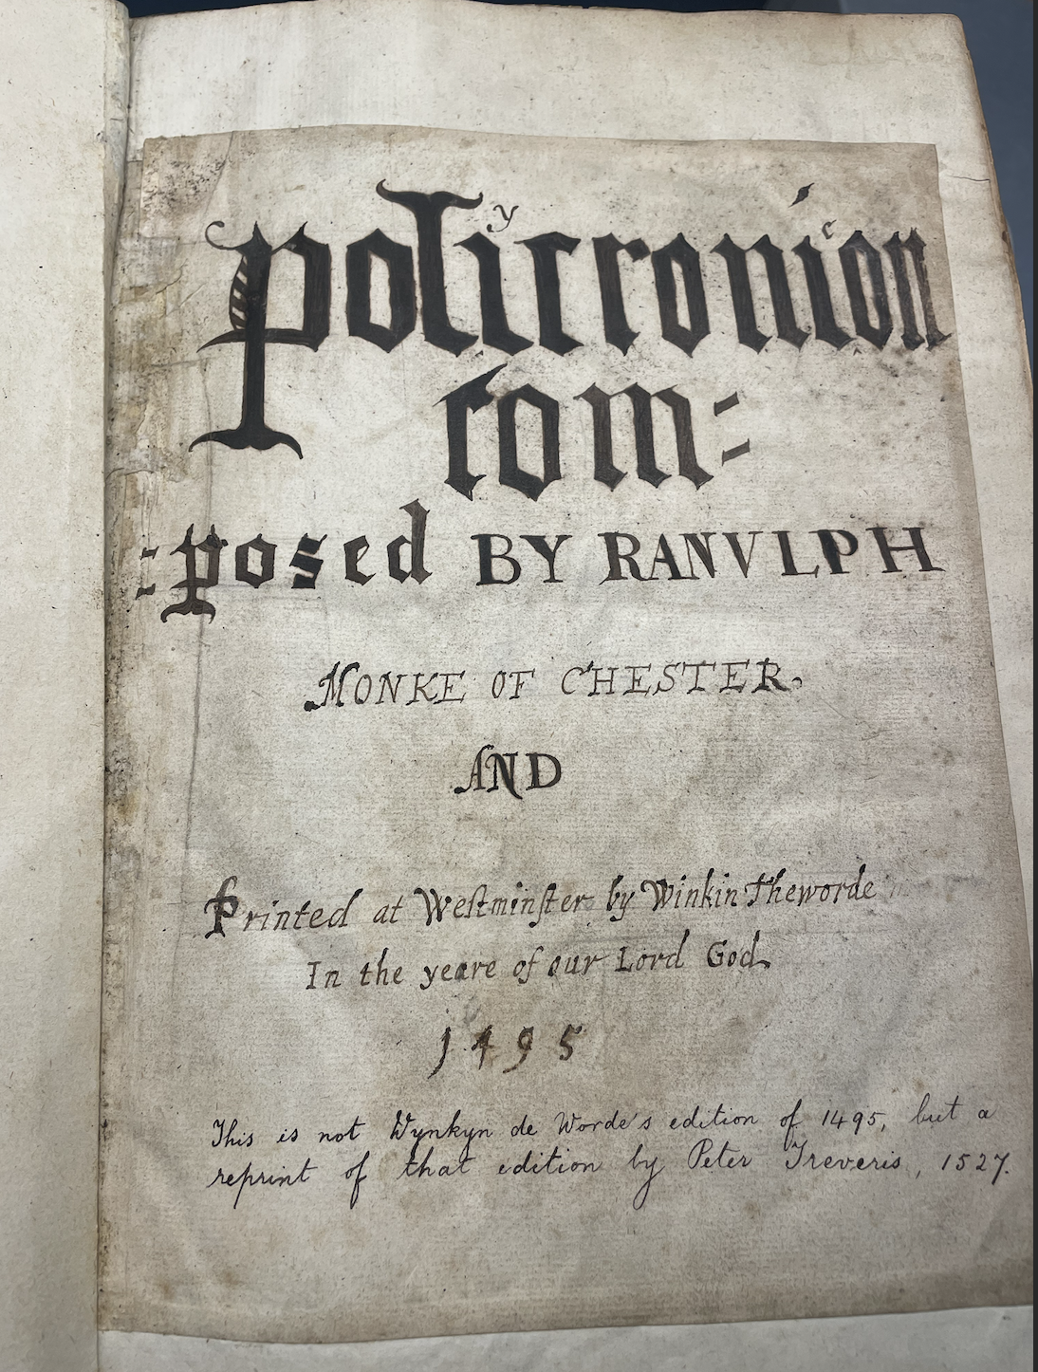
How to make a book?

