Slide 1

Guidance on completing Record of Processing Activities
(RoPA)
Maria Drzazga, GDPR Compliance Manager
Data Protection Office
February 2026

Slide 2
Guidance on completing Record of Processing Activities (RoPA)
What is RoPA and why is it necessary to complete it?
Definitions
  Personal data + anonymisation v pseudonymisation
  Special categories of personal data
  Processing of personal data
                Legal basis for processing personal data
    International transfer of personal data
    What information is required to complete a RoPA?
    How to create a RoPA for your unit?
How to submit your ROPA?

Slide 3
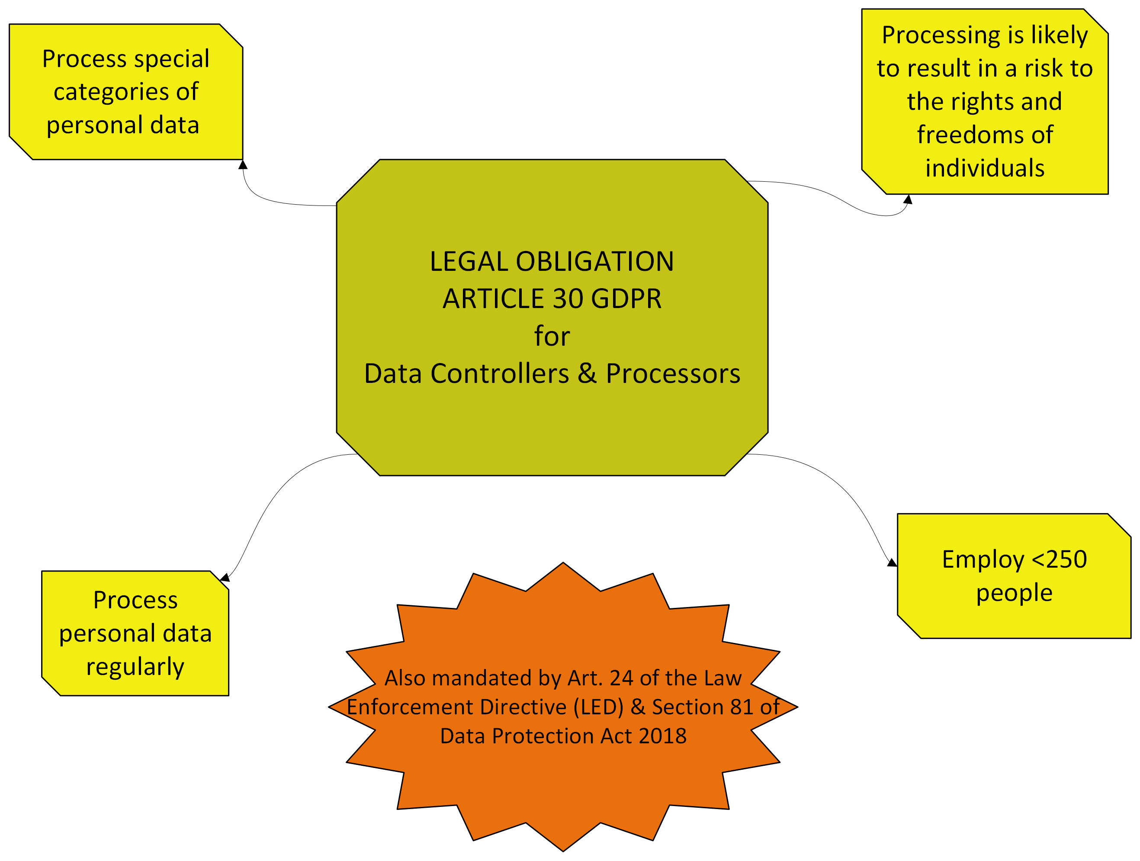
Why is it necessary to complete a RoPA?

Slide 4
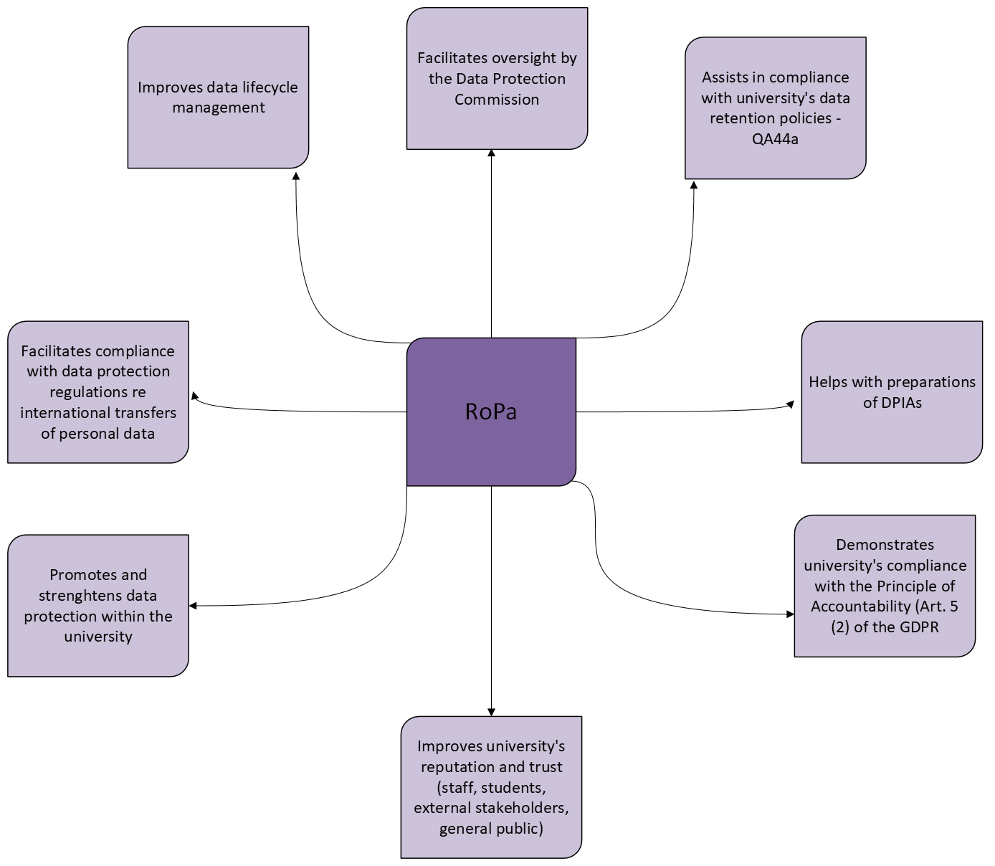
Why is it necessary to complete a RoPA? Cont.

Slide 5
Definitions – personal data
Broad definition – Article 4 of the GDPR: Any information relating to an identified or identifiable natural person (‘data subject’).
An identifiable natural person is one who can be identified, directly or indirectly, in particular by reference to an identifier such as a name, an identification number, location data, an online identifier or to one or more factors specific to the physical, physiological, genetic, mental, economic, cultural or social identity of that natural person.
IMPORTANT - Data may become personal from information that could likely come into the possession of a data controller
Anonymised v pseudonymised data:
Data is anonymised if an individual can no longer be identified by any means. Anonymisation cannot be reversed. GDPR does not apply.
Pseudonymisation of data means replacing any information which could be used to identify an individual with a pseudonym, or a value, which does not allow the individual to be directly identified. However, it still allows identification using indirect means. GDPR applies!
DPC: https://www.dataprotection.ie/en/dpc-guidance/anonymisation-pseudonymisation

Slide 6
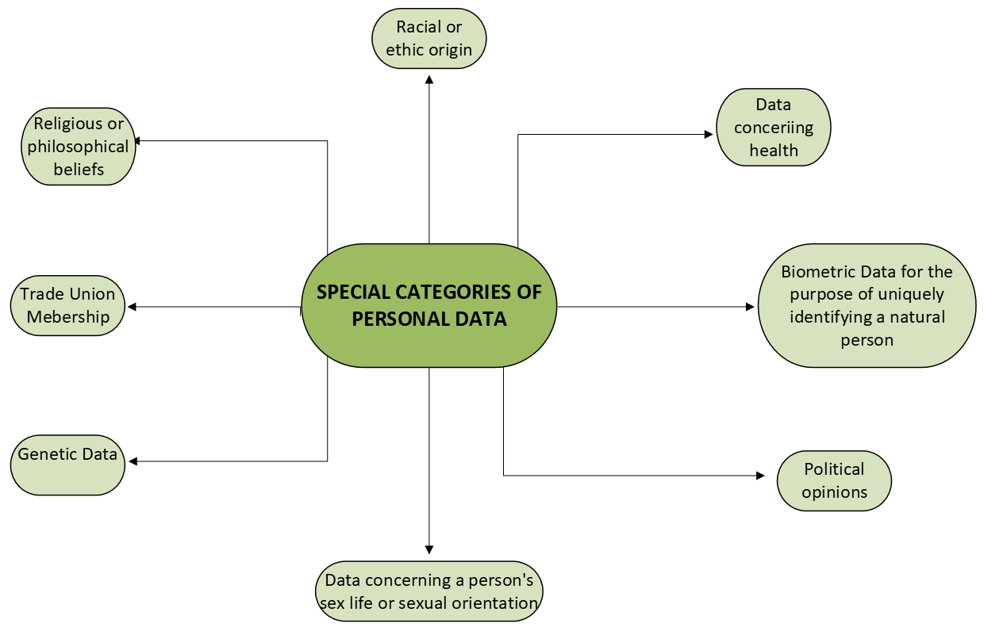
Definitions – Special categories of personal data
Art. 9 GDPR

Slide 7
Definitions – processing of personal data
What constitutes processing of personal data – broad definition in the GDPR:
“any operation or set of operations which is performed on personal data or on sets of personal data, whether or not by automated means, such as collection, recording, organisation, structuring, storage, adaptation or alteration, retrieval, consultation, use, disclosure by transmission, dissemination or otherwise making available, alignment or combination, restriction, erasure or destruction.”

Slide 8
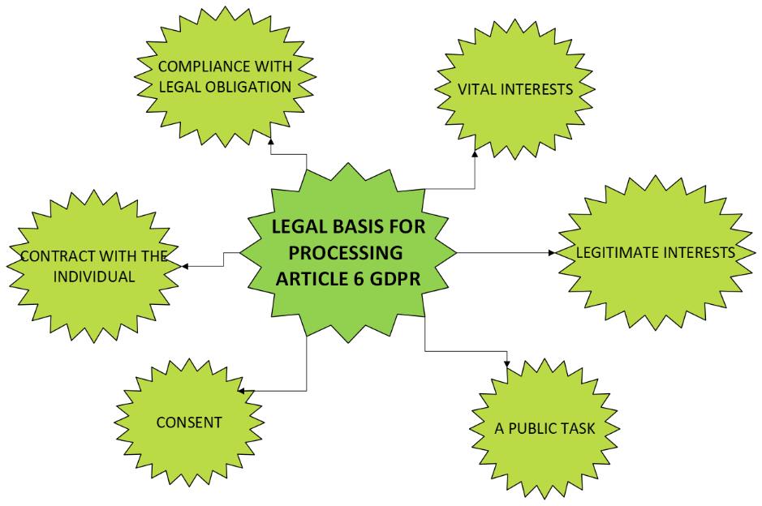
Legal Basis for processing of personal data (Article 6 GDPR)
If you are processing special categories of personal data, additionally you will need Article 9 condition for each of your processing activities

Slide 9
Legal basis for processing of personal data - Most Common Legal Basis for University Tasks
The University relies on the following legal basis for its processing of personal data:
Contract – where the University has a contract with the data subject, student or staff member;
Legal Obligation – where the University is legally obliged to process the personal data;
Public Task – where the University has been assigned a public task under statute;
Legitimate interests – where the University has a legitimate interest in the processing*;
Vital Interest – where the vital interests of an individual are at stake;
Consent – where the explicit consent of an individual has been obtained.
However, by far the most common legal basis the University relies upon for its data processing is Article 6 (1) (e) public task, and that task is set out in the Sections 12 & 13, the objects and functions of the Universities Act 1997.
*Legitimate interest assessment must be performed to ensure balance of power is not in issue.

Slide 10
Universities Act 1997 Section 12
The objects of a university shall include—
(a) to advance knowledge through teaching, scholarly research and scientific investigation,
(b) to promote learning in its student body and in society generally,
(c) to promote the cultural and social life of society, while fostering and respecting the diversity of the university's traditions,
(d) to foster a capacity for independent critical thinking amongst its students,
(e) to promote the official languages of the State, with special regard to the preservation, promotion and use of the Irish language and the preservation and promotion of the distinctive cultures of Ireland,
(f) to support and contribute to the realisation of national economic and social development,
(g) to educate, train and retrain higher level professional, technical and managerial personnel,
(h) to promote the highest standards in, and quality of, teaching and research,
(i) to disseminate the outcomes of its research in the general community,
(j) to facilitate lifelong learning through the provision of adult and continuing education, and
(k) to promote gender balance and equality of opportunity among students and employees of the university.

Slide 11
Universities Act 1997 Section 13
(…) a university—
(a) shall provide courses of study, conduct examinations and award degrees and other qualifications,
(b) shall promote and facilitate research,
(c) may establish by incorporation in the State or elsewhere, or participate in the establishment of, such trading, research or other corporations as it thinks fit for the purpose of promoting or assisting, or in connection with the functions of, the university,
(d) may collaborate with educational, business, professional, trade union, Irish language, cultural, artistic, community and other interests, both inside and outside the State, to further the objects of the university,
(e) shall maintain, manage and administer, and may dispose of and invest, the property, money, assets and rights of the university,
(f) may collaborate with graduates, convocations of graduates and with associations representing graduates of the university both inside and outside the State,
(g) may purchase or otherwise acquire, hold and dispose of land or other property, and
(h) may accept gifts of money, land or other property on the trusts and conditions, if any, not in conflict with this Act, specified by the donor.

Slide 12
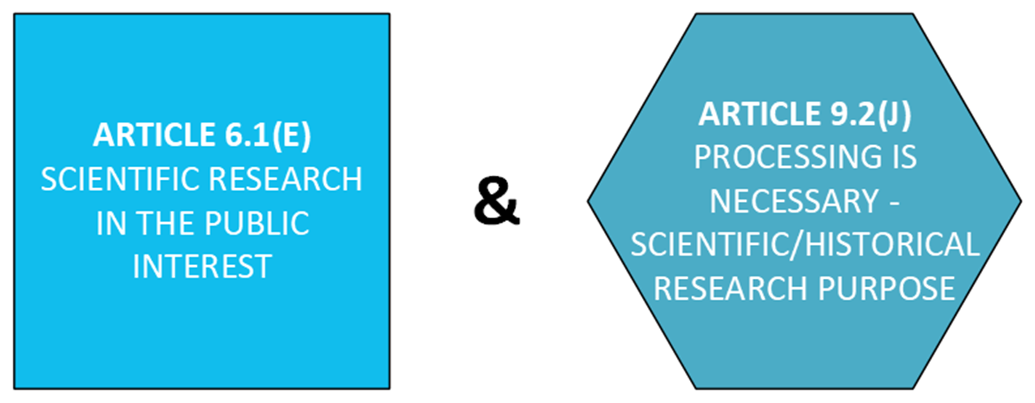
GDPR - Most Common Legal Basis for University Research Sector
•Scientific research in the public interest Article 6.1.(e) and condition Article 9.2(j)
•This would apply where the research is publicly funded and in the public interest, not necessarily applicable to commercially funded research.
•Additional requirement under HRR for explicit consent as a suitable and specific safeguard for Health research – not a legal basis for the processing.

Slide 13

International transfer of personal data
If you are transferring personal data outside of the EEA, you will need to use one of the mechanisms described in Chapter V of the GDPR. The most commonly used mechanisms are:
  Adequacy Decision from the European Commission – this means that the EC has deemed that country’s Data Protection regime is adequate and therefore you just need to have a contract in place. List of countries with Adequacy Decisions can be found here.
  Standard Contractual Clauses – need to be included in the contract.
In some exceptional cases, there may be other means of transferring the data, on a case by case basis.

Slide 14
What information is required to complete a RoPA?
Categories of personal data undergoing processing (name, address, D.O.B, financial information)
Categories of data subjects you process personal data for (staff, students, agency workers, contractors, research participants etc.).
What kind of documentation containing personal data does your unit deal with?
Do you process special categories of personal data?
What legal basis do you have for processing of personal data/special cat. of personal data?
Who do you share personal data with (internally and externally)?
Do you share personal data with other institutions based outside of EEA?
How long will you store personal data for - QA442 Data Retention Schedule
What security measures do you have in place?
Are you and your team trained in data protection and data security?

Slide 15
How to create a RoPA for your unit?
Download “ROPA Template for Units” Excel spreadsheet, available on the Data Protection webpage: https://www.universityofgalway.ie/data-protection/gdpr/ropa/
Complete tab “ROPA” – answer the questions for each processing activity
Complete tab ‘Legal basis’ – provide legal basis for each processing activity
Use information in the guidance tabs to answer the questions.
Keep RoPA up to date – it is a live document!
Keep RoPA secure – limit the number of staff members who can access the document.
For queries – contact dataprotection@universityofgalway.ie.

Slide 16

How to submit your RoPA via Ms Form
Visit ROPA webpage: https://www.universityofgalway.ie/data-protection/gdpr/ropa/
Fill out short RoPA MsForm and attach your completed ROPA.
Your ROPA will be reviewed by the Data Protection Team.

Slide 17
Additional resources
Data Protection – RoPA: https://www.universityofgalway.ie/data-protection/gdpr/ropa/
Data Protection training – live online sessions: https://www.universityofgalway.ie/data-protection/training/
Data Protection – Guidance & resources: https://www.universityofgalway.ie/data-protection/guidanceandresources/
Data Protection Commission Guidance on RoPA: https://www.dataprotection.ie/en/dpc-guidance/records-of-processing-article-30-guidance
Data Protection Policies and Procedures

Slide 18

Questions?
Contact us at
dataprotection@universityofgalway.ie
Or visit:
https://www.universityofgalway.ie/data-protection/
Photo by Simone Secci on Unsplash

Slide 19
Thank you

