Slide 1

Guidance on completing Record of Processing Activities (RoPA)
Maria Drzazga, GDPR Compliance Manager
Data Protection Office
January 2026

Slide 2
Guidance on completing Record of Processing Activities (RoPA)
What information is required to complete a RoPA?
Legal basis for processing personal data
International transfer of personal data
How to create a RoPA for your unit?
How to submit your ROPA?
Definitions
Personal data + anonymisation v pseudonymisation
Special categories of personal data
Processing of personal data
Why is it necessary to complete a RoPA?

Slide 3
Definitions – personal data
Broad definition – Article 4 of the GDPR: Any information relating to an identified or identifiable natural person (‘data subject’).
An identifiable natural person is one who can be identified, directly or indirectly, in particular by reference to an identifier such as a name, an identification number, location data, an online identifier or to one or more factors specific to the physical, physiological, genetic, mental, economic, cultural or social identity of that natural person.
IMPORTANT - Data may become personal from information that could likely come into the possession of a data controller
Anonymised v pseudonymised data:
Data is anonymised if an individual can no longer be identified by any means. Anonymisation cannot be reversed. GDPR does not apply.
Pseudonymisation of data means replacing any information which could be used to identify an individual with a pseudonym, or a value, which does not allow the individual to be directly identified. However, it still allows identification using indirect means. GDPR applies!

Slide 4
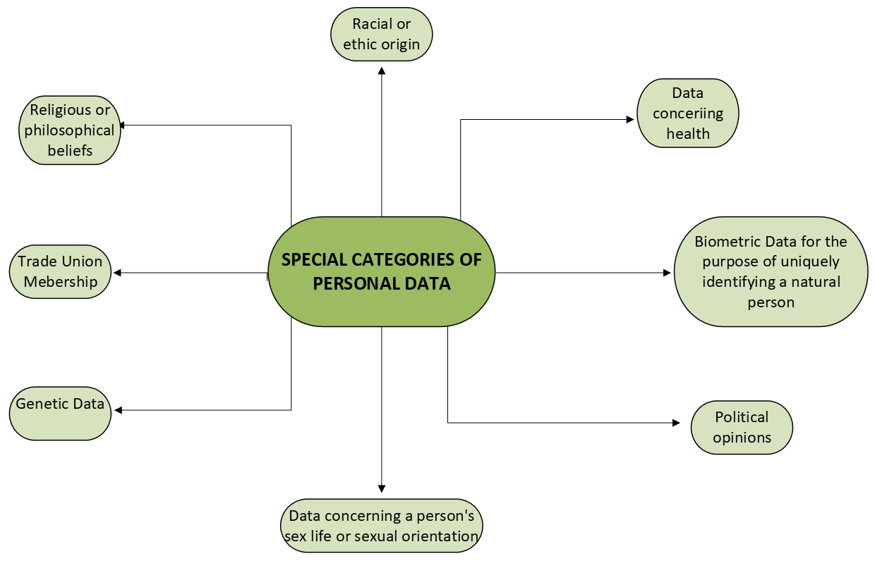
Definitions – Special categories of personal data

Slide 5
Definitions – processing of personal data
What constitutes processing of personal data – broad definition in the GDPR:
“any operation or set of operations which is performed on personal data or on sets of personal data, whether or not by automated means, such as collection, recording, organisation, structuring, storage, adaptation or alteration, retrieval, consultation, use, disclosure by transmission, dissemination or otherwise making available, alignment or combination, restriction, erasure or destruction.”

Slide 6
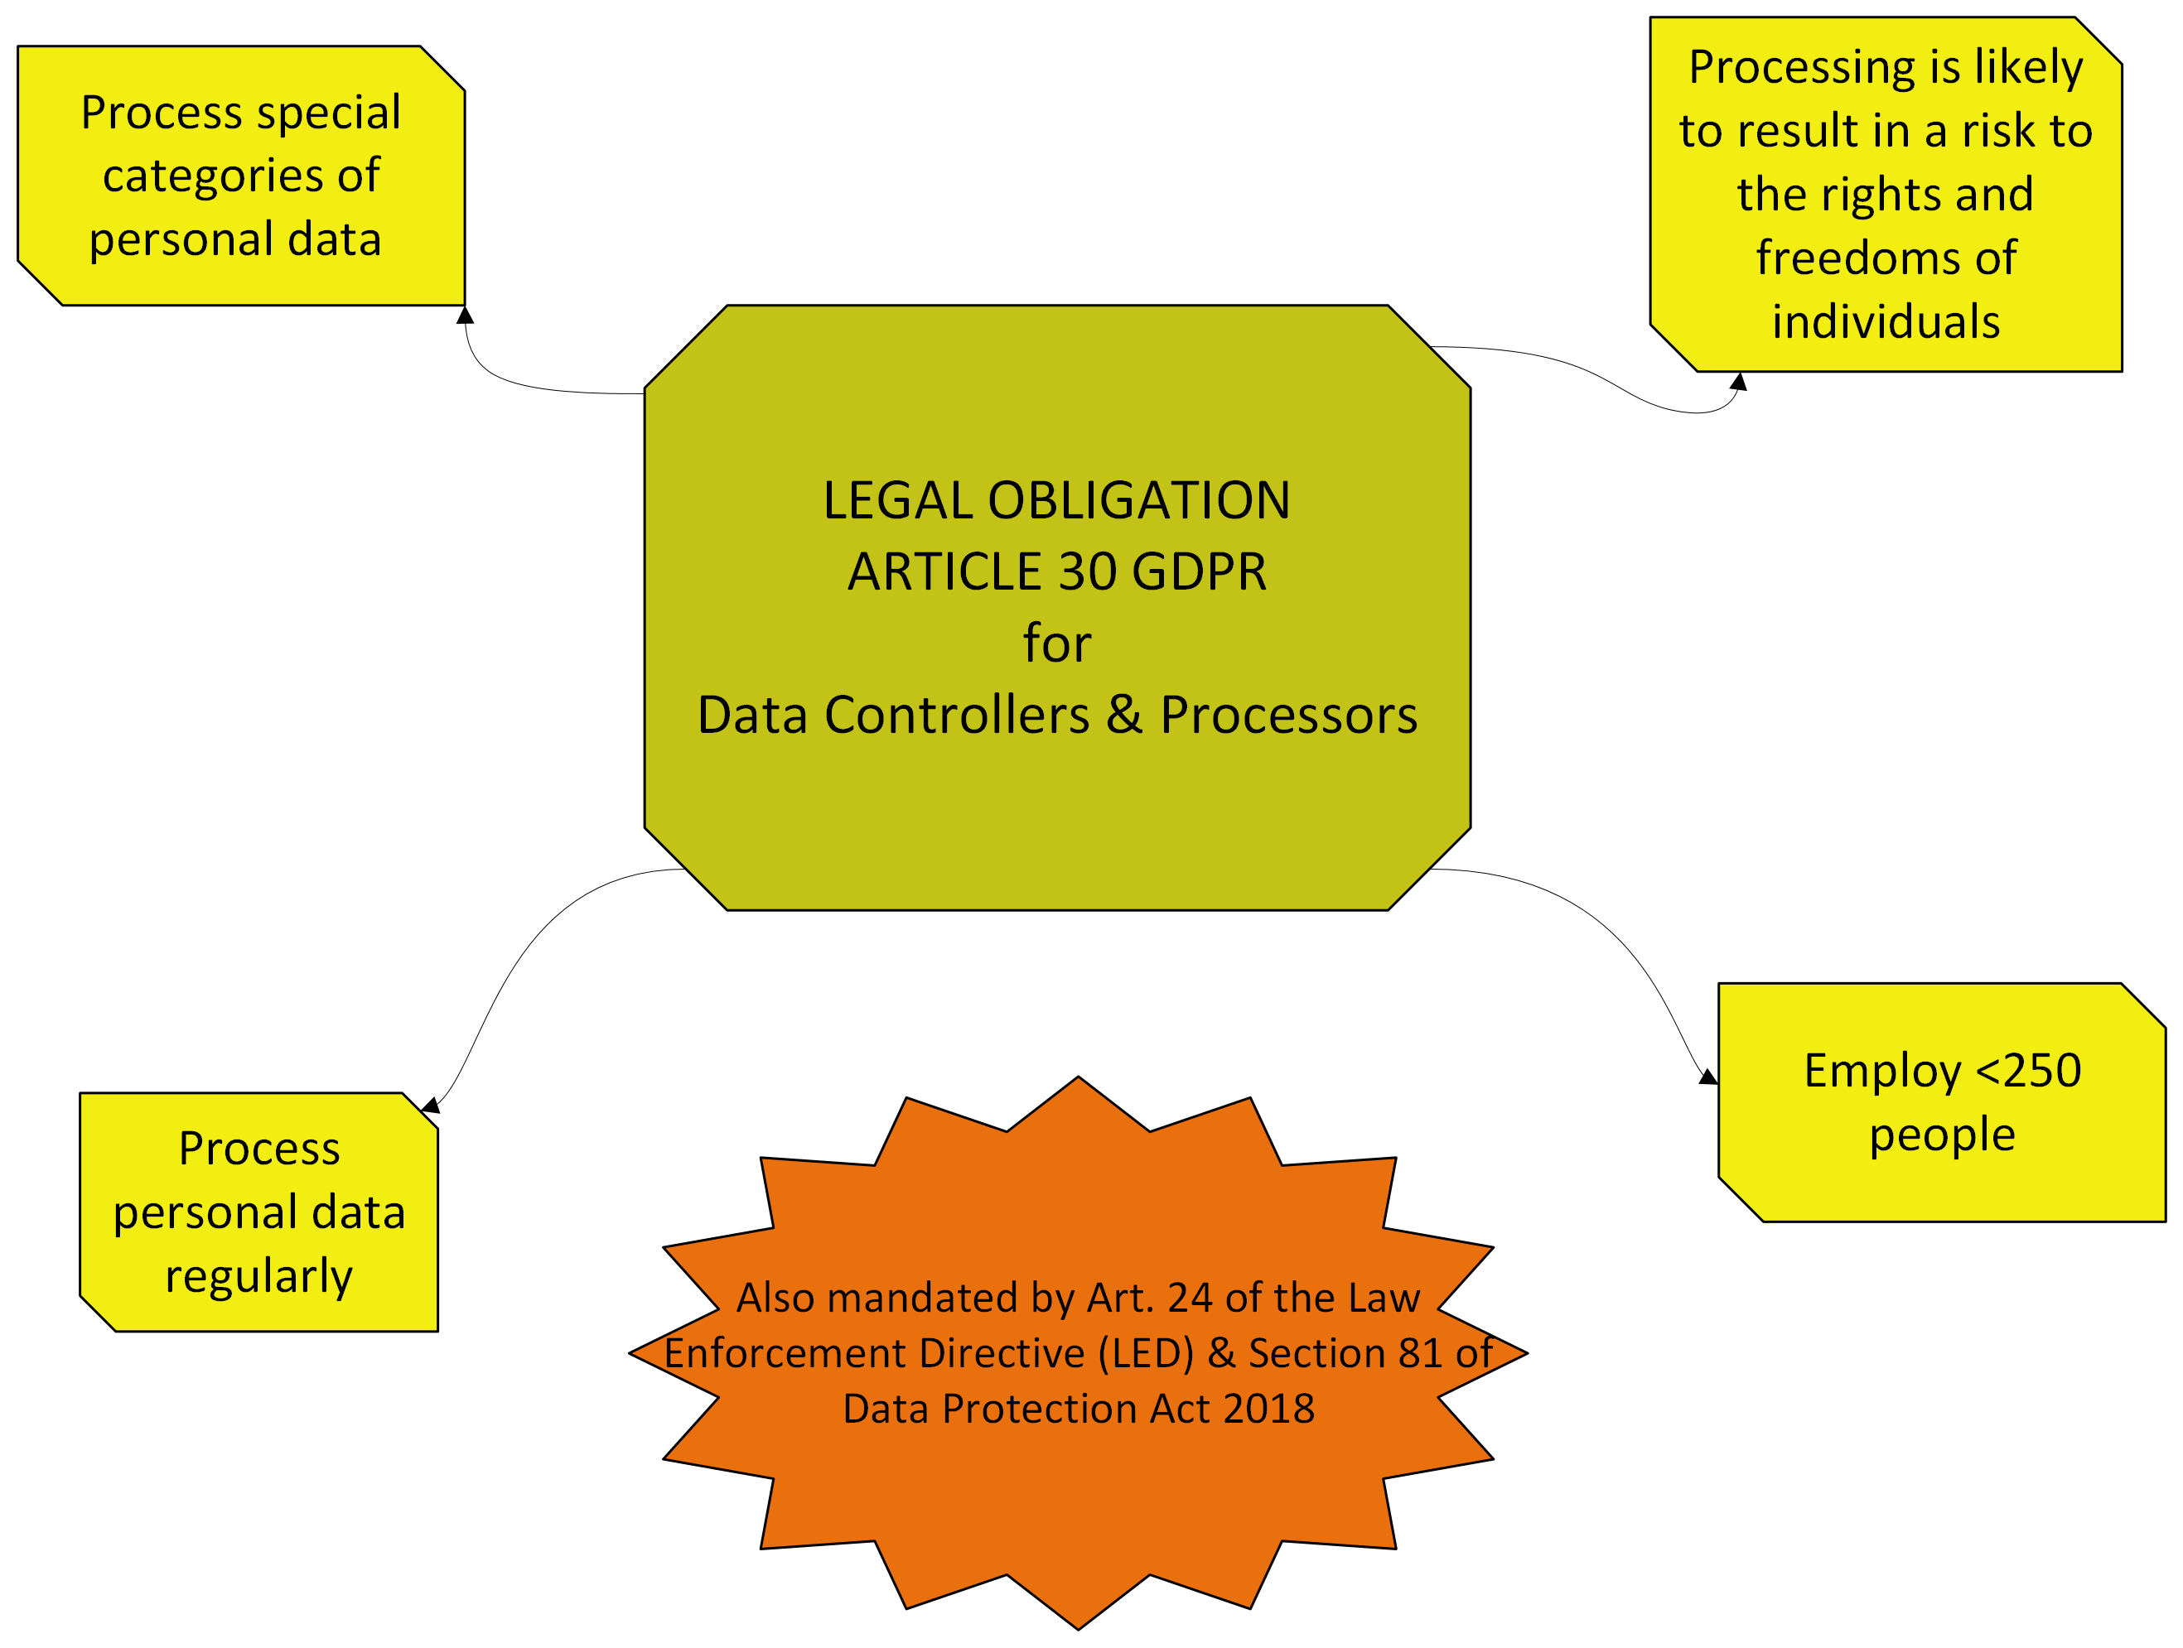
Why is it necessary to complete a RoPA?

Slide 7
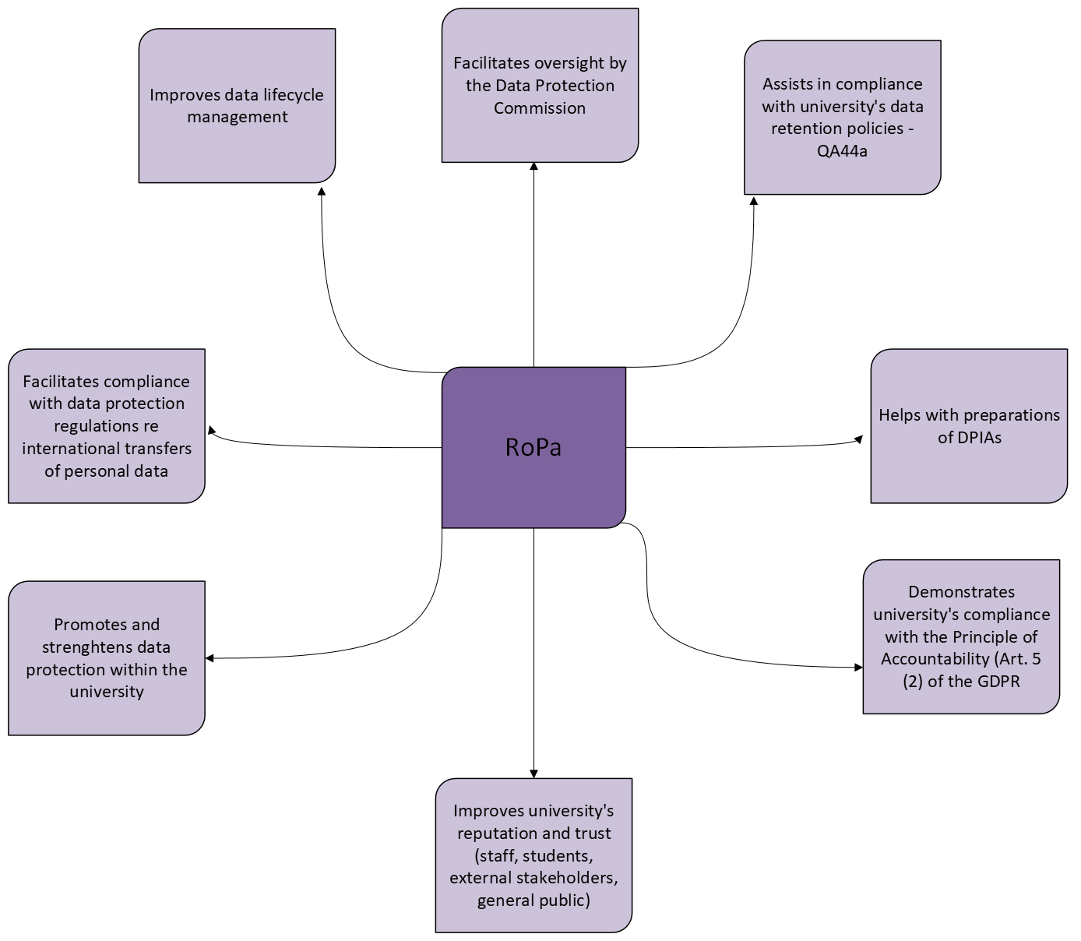
Why is it necessary to complete a RoPA? Cont.

Slide 8
What information is required to complete a RoPA?
Categories of personal data undergoing processing (name, address, D.O.B, financial information)
Categories of data subjects you process personal data for (staff, students, agency workers, contractors, research participants etc.).
What kind of documentation containing personal data does your unit deal with?
Do you process special categories of personal data?
What is the purpose of processing – legal basis for processing personal data and special categories of personal data (if applicable).
What legal basis do you have for sharing personal data?
Who do you share personal data with (internally and externally)?
Do you share personal data with other institutions based outside of EEA?
We are only required to record processing of data that is ongoing – not past (i.e. projects that had terminated).

Slide 9
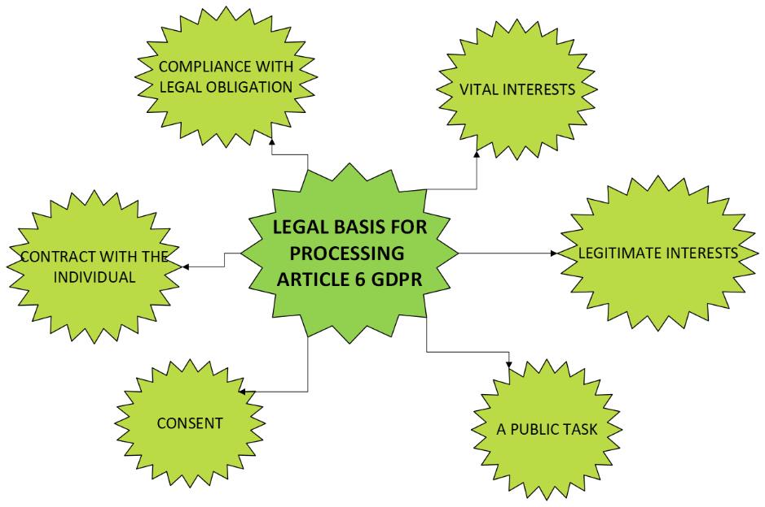
Legal Basis for processing of personal data (Article 6 GDPR)
If you are processing special categories of personal data, additionally you will need Article 9 condition for each of your processing activities

Slide 10
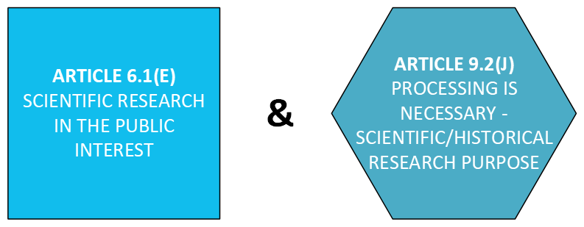
Legal basis for processing of personal data - Most Common Legal Basis for University Sector Research
Scientific research in the public interest Article 6.1.(e) and condition Article 9.2(j)
This would apply where the research is publicly funded and in the public interest, not necessarily applicable to commercially funded research.
Additional requirement under HRR for explicit consent as a suitable and specific safeguard for Health research – not a legal basis for the processing.

Slide 11

International transfer of personal data
If you are transferring personal data outside of the EEA, you will need to use one of the mechanisms described in Chapter V of the GDPR. The most commonly used mechnisms are:
Adequacy Decision from the European Commission – this means that the EC has deemed that country’s Data Protection regime is adequate and therefore you just need to have a contract in place. List of countries with Adequacy Decisions can be found here.
Standard Contractual Clauses – need to be included in the contract.
In some exceptional cases, there may be other means of transferring the data, on a case by case basis

Slide 12
How to create a RoPA for your unit?
Download “ROPA Template for Units” Excel spreadsheet, available on the Data Protection webpage: https://www.universityofgalway.ie/data-protection/gdpr/ropa/
Complete tab “ROPA” – answer the questions for each processing activity
Complete tab ‘Legal basis’ – provide legal basis for each processing activity
Use information in the guidance tabs to answer the questions.
Keep RoPA up to date – it is a live document!
Keep RoPA secure – limit the number of staff members who can access the document.
For queries – contact dataprotection@universityofgalway.ie.

Slide 13

How to submit your RoPA via Ms Form
Visit ROPA webpage: https://www.universityofgalway.ie/data-protection/gdpr/ropa/
Fill out short RoPA MsForm and attach your completed ROPA.
Your ROPA will be reviewed by the Data Protection Team.

Slide 14

Questions?
Contact us at
dataprotection@universityofgalway.ie
Or visit:
https://www.universityofgalway.ie/data-protection/
Photo by Simone Secci on Unsplash

Slide 15
Thank you

