Slide 1
University of Galway
AVC opportunities 2025
Eoghan Griffin

Slide 2
Main Scheme Benefit Structure

Slide 3

Should you consider an AVC
When did you join the scheme ?
What potential service do you have at Retirement ?
Is your benefit based on Final Salary or Career Average ?
A brief overview of main scheme benefit structure is detailed on the following slides

Slide 4
Public Sector Schemes
Some key dates
6 April 1995
Integration with State Pension (maximum contributory rate)
New entrants after that date pay PRSI Class A
  Entitled to contributory State Pension
  Lower pension from superannuation scheme to take this into account
  State funded
1 April 2004
Change of NRA for new entrants from 60 to 65
Cost neutral early retirement
  Existing members from 50 and new members from 55

Slide 5
Public Sector Schemes
Normal Retirement Age
Date joined | Before 6 April 1995 | 6 April 1995 to 31 March 2004 | 1 April 2004 to 1 January 2013 | After 1 January 2013
Min retirement age | NRA 60 | NRA 60 | NRA 65 | NRA 66
Max retirement age | Compulsory at 70 | Compulsory at 70 | None specified | Compulsory at 70
Early retirement age | 50 | 50 | 55 | 55

Slide 6
Main
Scheme Benefits

Slide 7
What benefits are provided?
  Retirement Pension
  Retirement Lump Sum (gratuity)
  Spouses Pension on death in retirement

Slide 8
Public Sector Schemes
Pensionable service
Benefits based on the following types of service:
  Full time service
  Job sharing, work sharing or part time service
    Full time equivalent
    Benefits based on full time salary (grade level)
  Transferred in service
  Notional service purchased
  Added years
  Service derived from a DC transfer in

Slide 9
Public Sector Schemes
Part time service example
Full time service of 10 years
Part time service of 15 years
Full time employment = 40 hours a week
Worked a 30 hour week for 15 years
Converted part time service 15 x 30/40 = 11.25 years
Total service 10+11.25 = 21.25
Actual final year of earnings (working part time at NRA) = €40,000
Full time salary grade = €54,000
Joined before 1/4/1995 (no offset)
Pension = 1/80 x 21.25 x €54,000 = €14,344
Lump sum = 3/80 x 21.25 x €54,000 = €43,031

Slide 10
Public Sector Schemes
Single Public Sector Scheme
All new entrants since 1 January 2013
  Including any returning public servants after a break of more than 26 weeks
Benefits based on career averaging
  Integrated salary
CPI indexation between the year of accrual and retirement

Slide 11
AVC Scheme
Death in service feature
Where a member is paying AVCs at date of death
Guaranteed death benefit of €10,000 applies
Higher of fund value or €10,000
Does not apply where AVC is paid up

Slide 12
Why do an AVC?

Slide 13
Why do an AVC?
Lump Sum Shortfall
Maximum
Dependants Pension
Non-Pensionable Payments
Funding for Early Retirement
Fund for Integration
Main Scheme

Slide 14
AVC opportunity
Funding for lump sum shortfall
Example
Mary is due to retire in 5 years time with 33 years of service completed
Current salary €50,000
Estimated tax-free lump sum = 33x3/80 x €50,000 = €61,875
Revenue maximum lump sum = 1.5 x €50,000 = €75,000
Shortfall = €13,125
Estimated contribution required to fund this circa €200 per month

Slide 15
AVC opportunity
Funding for Early Retirement (lump sum)
Example 2
Sean is retiring early at 55 with 15 years of service
Salary €60,000 and NRA 65
Calculation | Amount
15x3/80 x €60,000 | €33,750
15/25 x (1.5 x €60,000 - €0) | €54,000
72/80 x €60,000 | €54,000
1.5 x €60,000 - €0 | €90,000
Reduced lump sum from Main Scheme 15x3/80 x €60,000 x 82.4% | €27,810
Scope for AVC €54,000 - €27,810 | €26,190

Slide 16
AVC opportunity
Funding for Revenue maximum dependants benefits
Example
Fiona is 40 and married and will have 40 years service at NRA 65
Current pensionable salary €40,000
Estimated pension (using 2% indexation) = 40/80 x €66,000 = €33,000
Dependants pension 50% x €33,000 = €16,500
Revenue dependants pension 100% x €33,000
Fund required to bridge the shortfall €200,000
Estimated contribution required to fund this circa €400 per month
€200,000 ARF at the end for Fiona (assuming no lump sum shortfall)

Slide 17
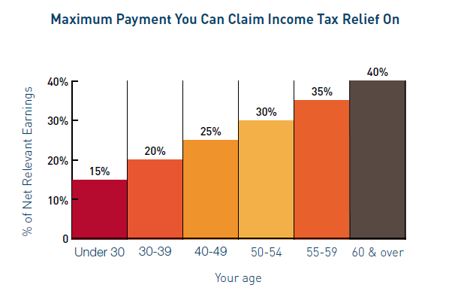
Public Sector Schemes
Maximum contribution for tax relief
Includes the employee contributions paid to the Public Sector Scheme
Earnings cap €115,000

Slide 18



Public Sector Schemes
Tax benefits
Generous Tax relief on contributions
Tax free growth on contributions paid
Tax free lump sum at retirement (potential)

Slide 19
Public Sector Schemes
Contributions for tax relief limits
Employee contributions paid during that tax year
AVCs
  Regular contributions
  Lump sums
Contributions used to purchase notional service
Group Life scheme contribution
Does not include the ASC (even though Income Tax relief was allowed)

Slide 20
Public Sector Schemes
Claiming Income Tax relief
Contributions deducted at source relief through net pay
Lump sum contributions claim to Revenue required
Can backdate claim for relief to previous tax year (1 year only)
  If paid before 31 October
  Or ROS deadline applicable in each year
  Un-used relief for the previous tax year
  Can result in repayment of tax as part of the claim
Can spread relief forward (no restrictions on time period)

Slide 21
Public Sector Schemes
What are the benefits of an AVC?
The ability to use some or all of your AVC fund as a tax-free lump sum
  Up to Revenue maximum salary and service limits
The ARF option
  Flexibility in retirement
  Compliments the guaranteed income
  Can be passed to the Estate on death
Alternatively
  Taxable cash
  Annuity

Slide 22
Notional Service

Slide 23
Public Sector Schemes
Purchasing notional service
Buying benefits based on shortfall in service
  No annuity or investment risk
  No ARF option
  Tax relief in the same way as AVCs
  Tax relief limits apply
Purchasing all the benefits for each year
  Pension
  Gratuity
  Dependants pension
  Pension increases
Please refer to the University website for further information

Slide 24
For any question please contact Eoghan Griffin
New Ireland Assurance
Mobile 086 1742356
E-mail: Eoghan.Griffin@newireland.ie

